Slide 1


Azərbaycan Dövlət Neft və Sənaye Universiteti
Calculus
Single Variable

Slide 2

Applications of Differentiation:
Rolle$’$s Theorem and
Mean Value Theorem

Slide 3

The Extreme Value Theorem states that a continuous function on a closed interval must have both a minimum and a maximum on the interval.
Both of these values$,$ however$,$ can occur at the endpoints.

Slide 4
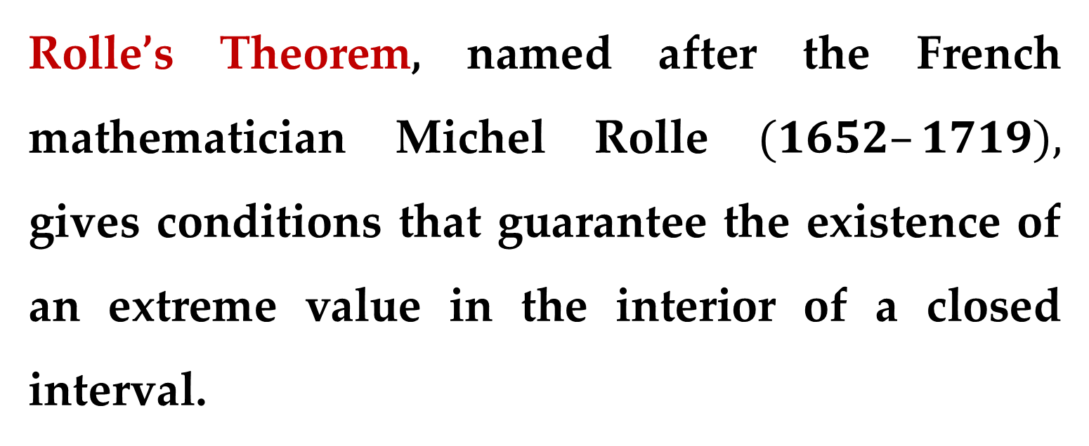
Rolle’s Theorem, named after the French mathematician Michel Rolle $(1652–1719),$ gives conditions that guarantee the existence of an extreme value in the interior of a closed interval.

Slide 5
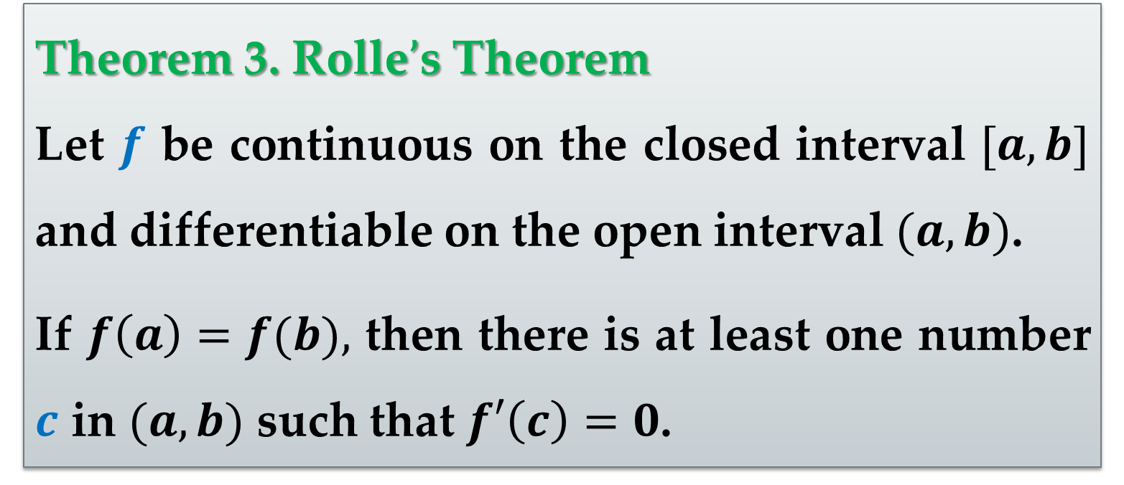
Theorem 3. Rolle$’$s Theorem
Let $f$ be continuous on the closed interval $[a,b]$ and differentiable on the open interval $(a,b)$.
If $f\left(a\right)=f(b),$ then there is at least one number $c$ in $(a,b)$ such that $f′\left(c\right)=0$.

Slide 6

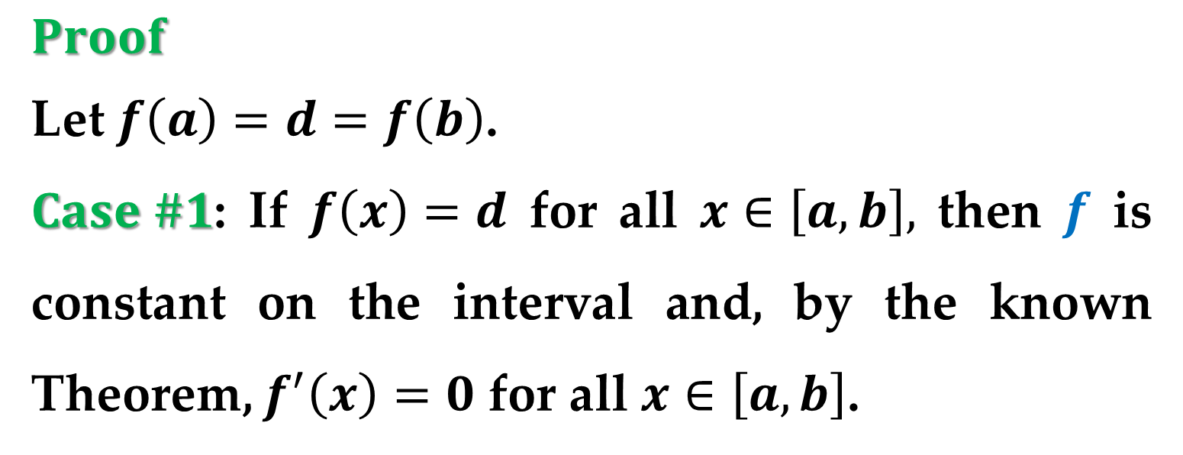
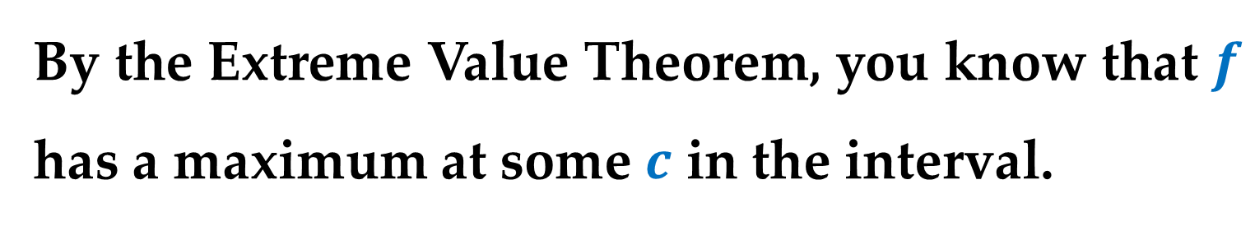
$Proof$
Let $f\left(a\right)=d=f\left(b\right)$.
$Case \#1$: If $f\left(x\right)=d$ for all $x∈\left[a,b\right],$ then $f$ is constant on the interval and, by the known Theorem, $f^{′}\left(x\right)=0$ for all $x∈\left[a,b\right]$.
$Case \#2$: Suppose $f\left(x\right)>d$ for some $x$ in $\left[a,b\right]$.
By the Extreme Value Theorem, you know that $f$ has a maximum at some $c$ in the interval.

Slide 7
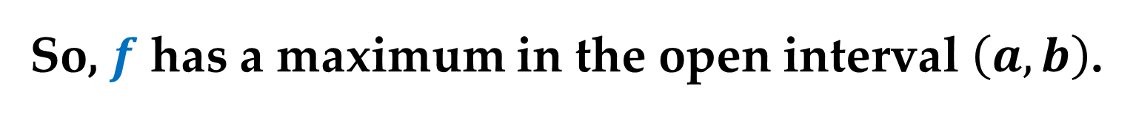


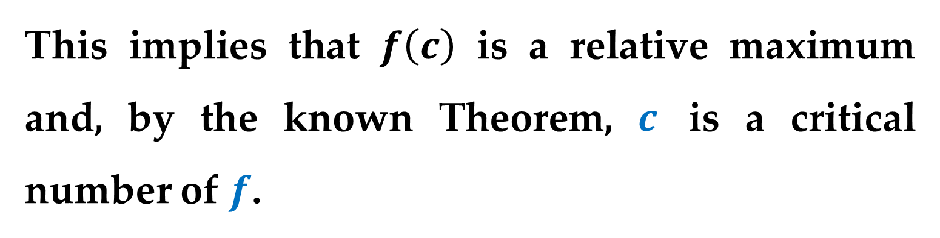
$Proof (continued)$
Moreover, because $f\left(c\right)>d,$ this maximum does not occur at either endpoint.
So, $f$ has a maximum in the open interval $\left(a,b\right)$.
This implies that $f\left(c\right)$ is a relative maximum and, by the known Theorem, $c$ is a critical number of $f$.
Finally, because $f$ is differentiable at $c,$ you can conclude that $f^{′}\left(c\right)=0$.

Slide 8
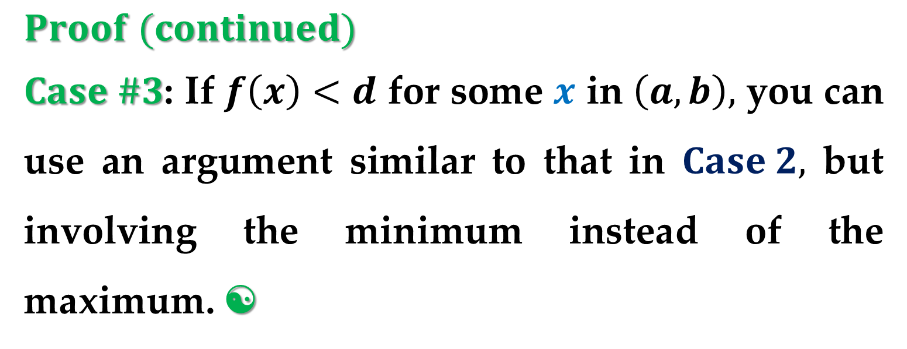
$Proof (continued)$
$Case \#3$: If $f\left(x\right)<d$ for some $x$ in $\left(a,b\right),$ you can use an argument similar to that in $Case 2,$ but involving the minimum instead of the maximum. 

Slide 9
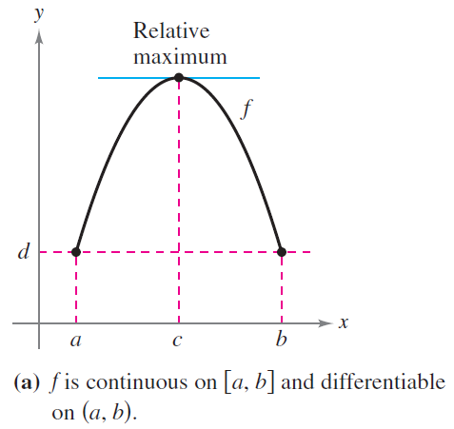
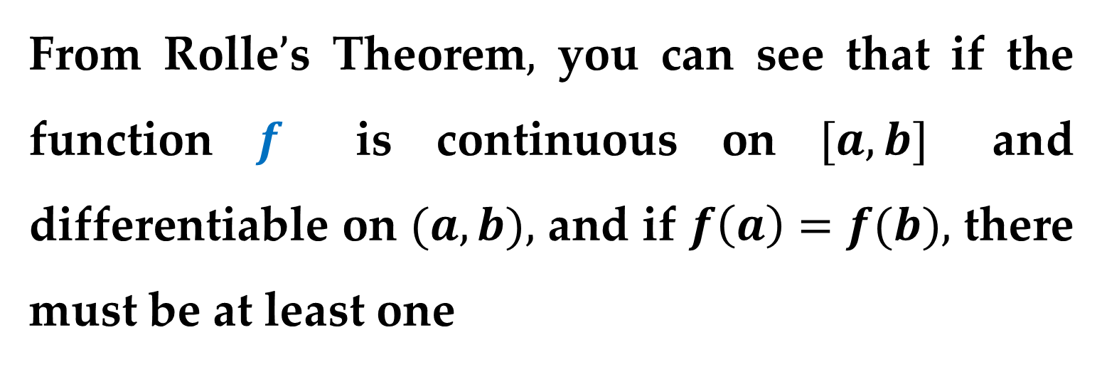
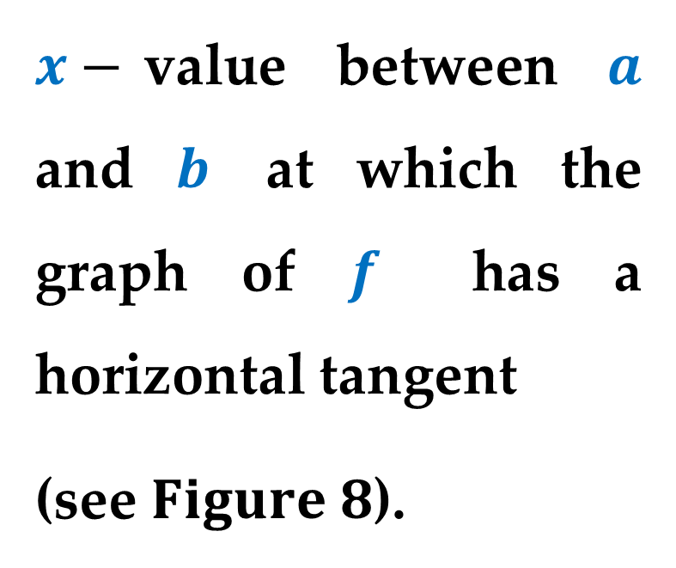
From Rolle$’$s Theorem$,$ you can see that if the function $f$ is continuous on $[a,b]$ and differentiable on $(a,b),$ and if $f\left(a\right)=f(b),$ there must be at least one
$x−$value between $a$ and $b$ at which the graph of $f$ has a horizontal tangent
(see $Figure 8$).

Slide 10
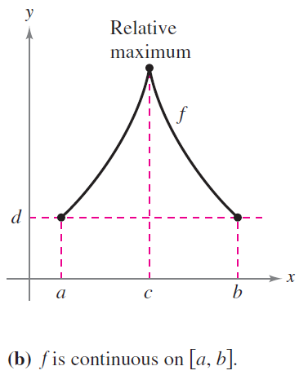
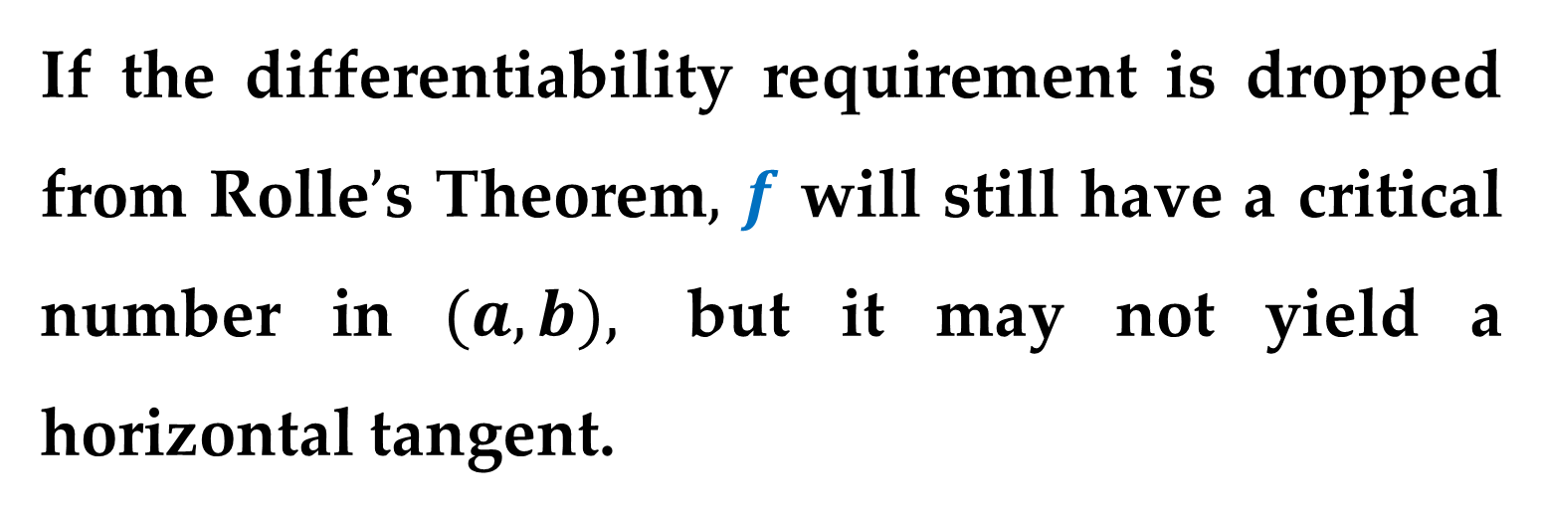
If the differentiability requirement is dropped from Rolle$’$s Theorem$,$ $f$ will still have a critical number in $(a,b),$ but it may not yield a horizontal tangent.

Slide 11
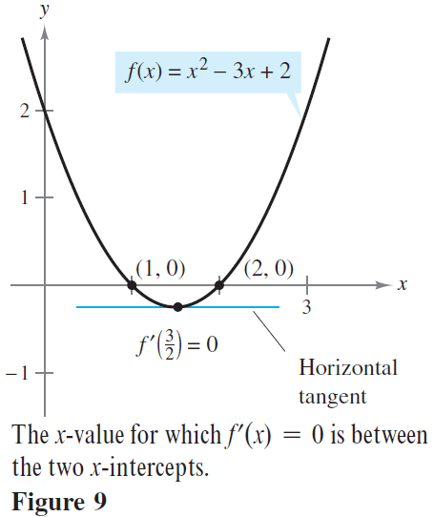
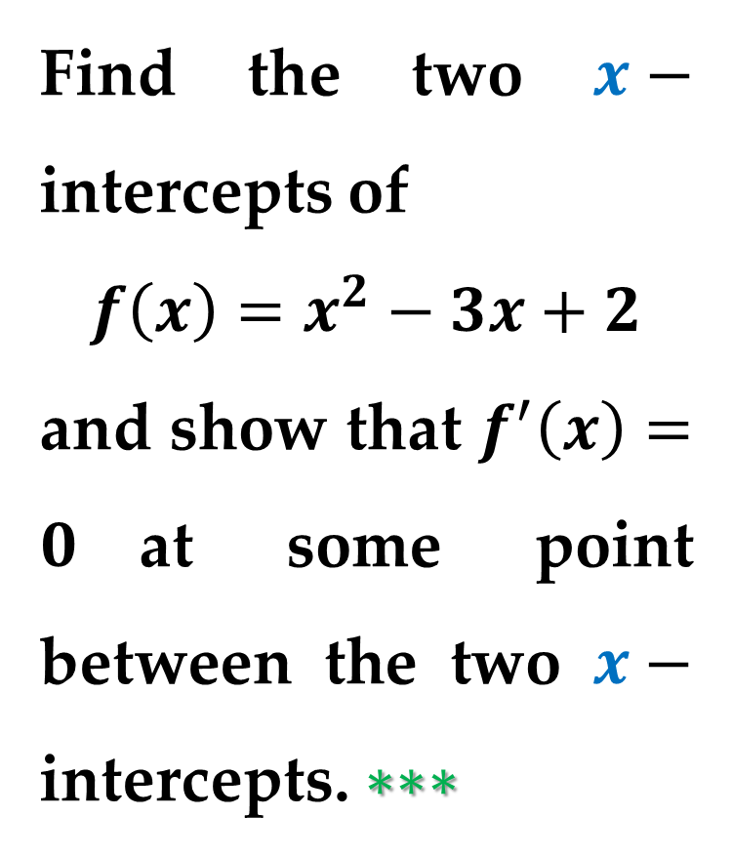
Example 1. Illustrating Rolle$’$s Theorem
Find the two $x−$ intercepts of
$$f\left(x\right)=x^{2}−3x+2$$
and show that $f^{′}\left(x\right)=0$at some point between the two $x−$ intercepts. $∗∗∗$

Slide 12
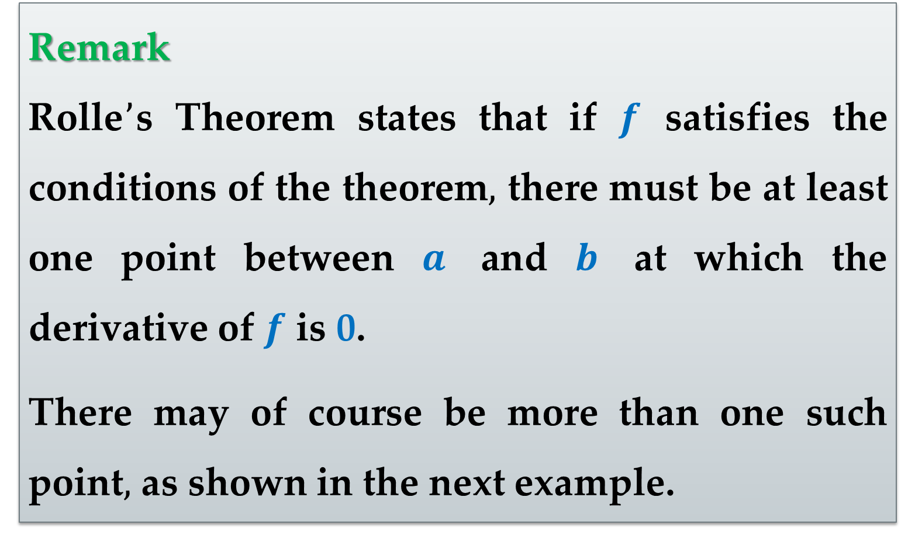
Remark
Rolle$’$s Theorem states that if $f$ satisfies the conditions of the theorem$,$ there must be at least one point between $a$ and $b$ at which the derivative of $f$ is 0.
There may of course be more than one such point$,$ as shown in the next example.

Slide 13
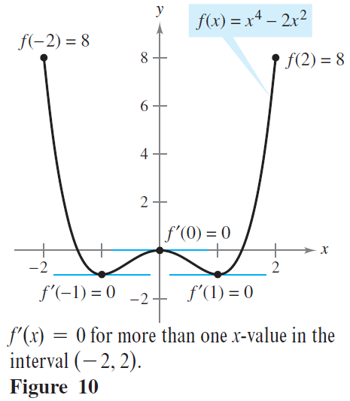
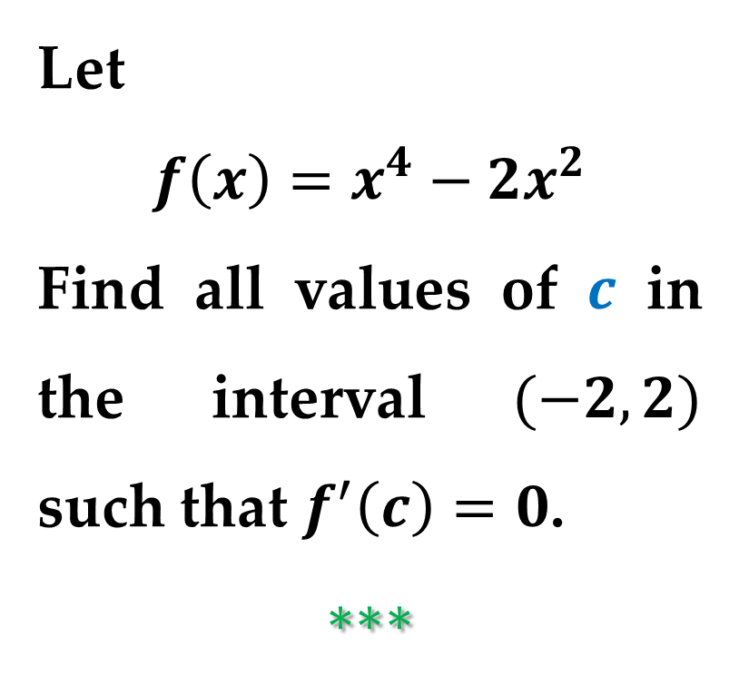
Example 2. Illustrating Rolle$’$s Theorem
Let
$$f\left(x\right)=x^{4}−2x^{2}$$
Find all values of $c$ in the interval $(−2,2)$ such that $f^{′}\left(c\right)=0$.
$$∗∗∗$$

Slide 14
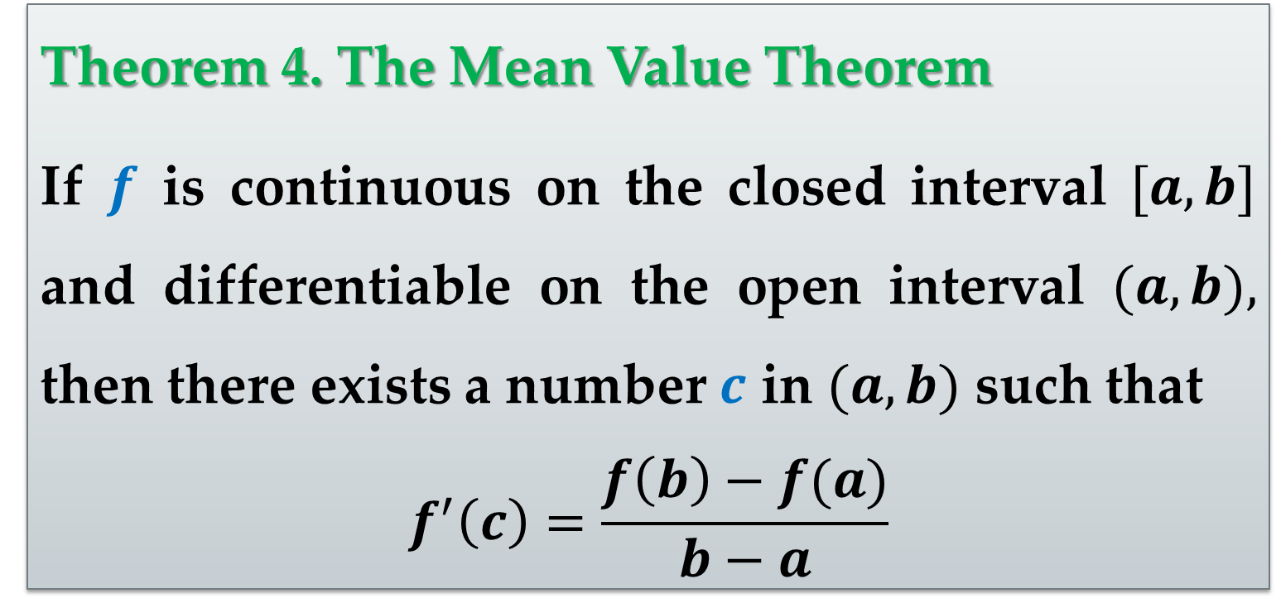

Rolle$’$s Theorem can be used to prove another theorem — the $Mean Value Theorem$.
Theorem 4. The Mean Value Theorem
If $f$ is continuous on the closed interval $[a,b]$ and differentiable on the open interval $(a,b),$ then there exists a number $c$ in $(a,b)$ such that
$$f^{′}\left(c\right)=\frac{f\left(b\right)−f(a)}{b−a}$$

Slide 15
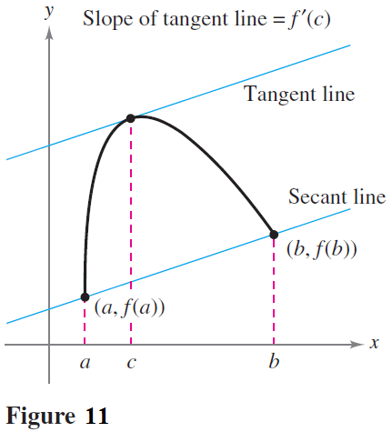
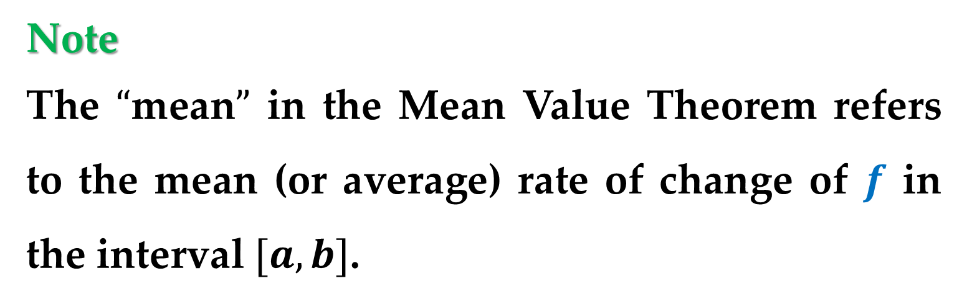
Note
The $“$mean$”$ in the Mean Value Theorem refers to the mean (or average) rate of change of $f$ in the interval $[a,b]$.
Guidelines to Proof
Refer to Figure 11.

Slide 16
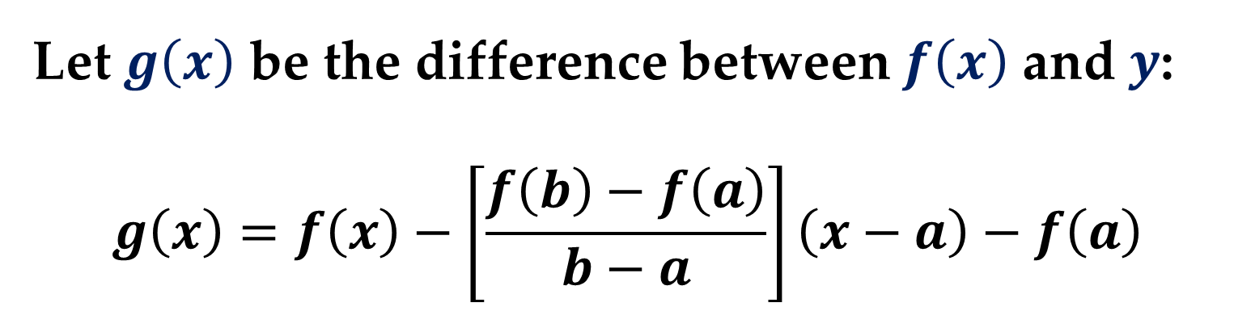
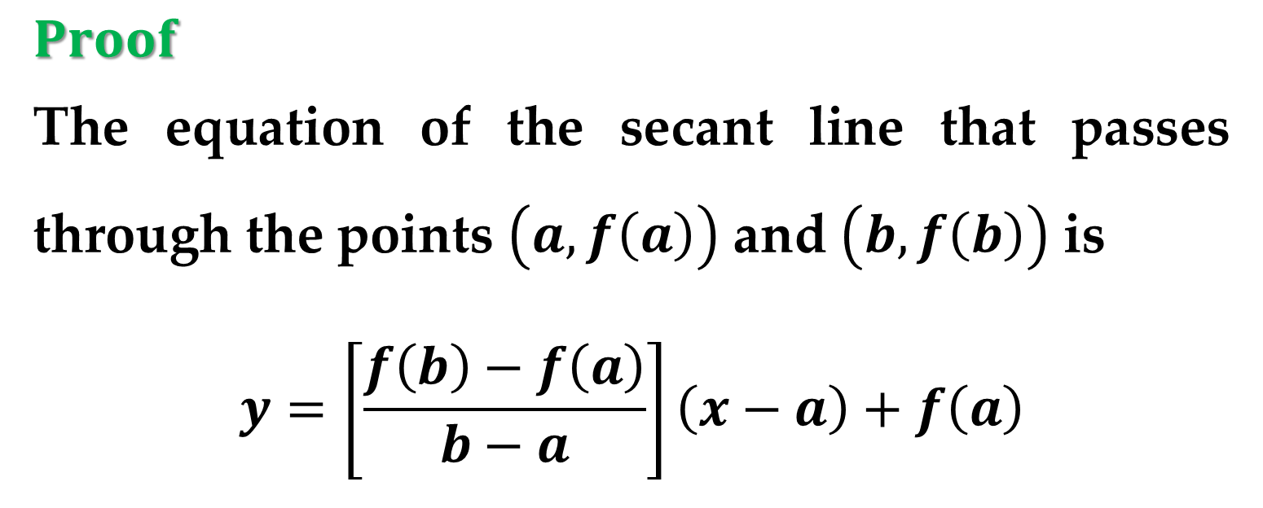
$Proof$
The equation of the secant line that passes through the points $\left(a,f\left(a\right)\right)$ and $\left(b,f\left(b\right)\right)$ is
$$y=\left[\frac{f\left(b\right)−f\left(a\right)}{b−a}\right]\left(x−a\right)+f\left(a\right)$$
Let $g\left(x\right)$ be the difference between $f\left(x\right)$ and $y$:
$$g\left(x\right)=f\left(x\right)−\left[\frac{f\left(b\right)−f\left(a\right)}{b−a}\right]\left(x−a\right)−f\left(a\right)$$

Slide 17


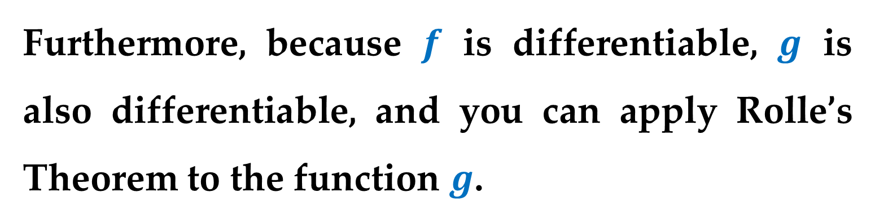
$Proof (continued)$
By evaluating $g$ at $a$ and $b$ you can see that
$$g\left(a\right)=0=g\left(b\right)$$
Because $f$ is continuous on $\left[a,b\right],$ it follows that $g$ is also continuous on $\left[a,b\right]$.
Furthermore, because $f$ is differentiable, $g$ is also differentiable, and you can apply Rolle’s Theorem to the function $g$.

Slide 18
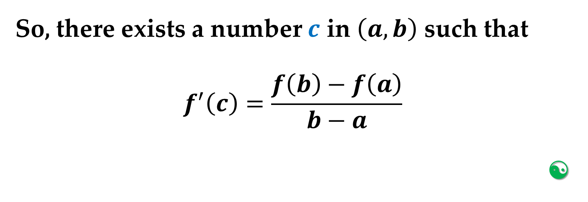
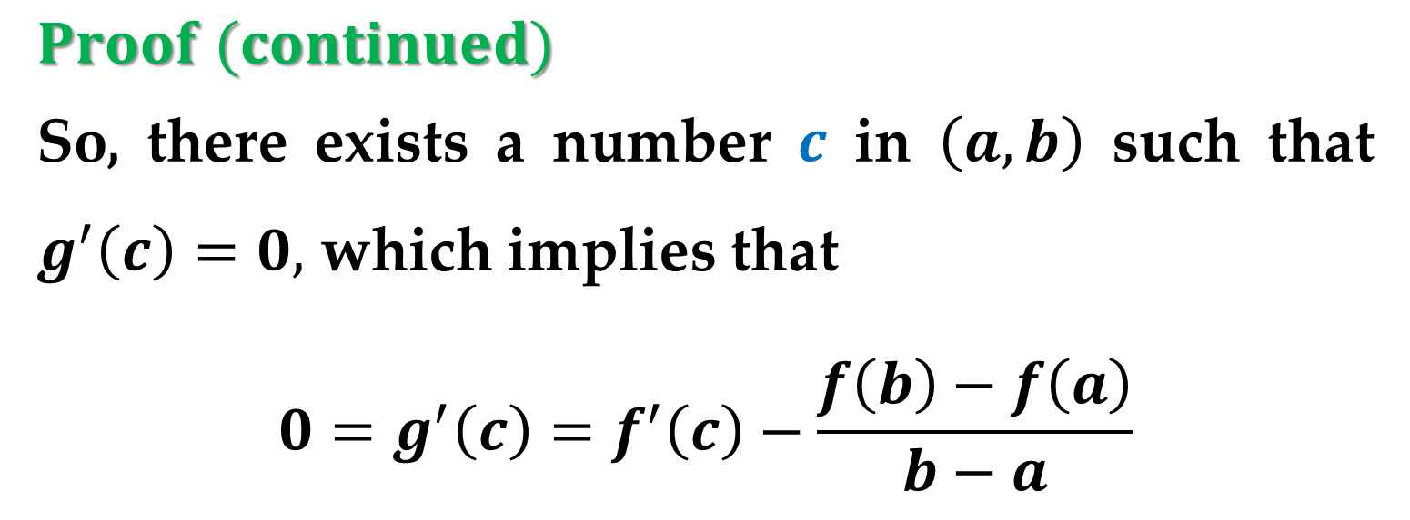
$Proof (continued)$
So, there exists a number $c$ in $\left(a,b\right)$ such that $g^{′}\left(c\right)=0,$ which implies that
$$0=g^{′}\left(c\right)=f^{′}\left(c\right)−\frac{f\left(b\right)−f\left(a\right)}{b−a}$$
So, there exists a number $c$ in $\left(a,b\right)$ such that
$$f^{′}\left(c\right)=\frac{f\left(b\right)−f\left(a\right)}{b−a}$$


Slide 19
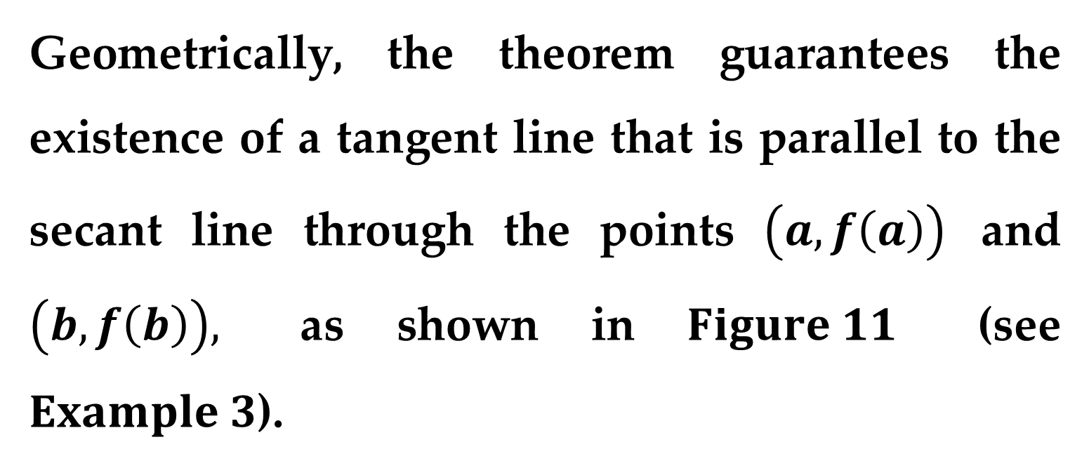
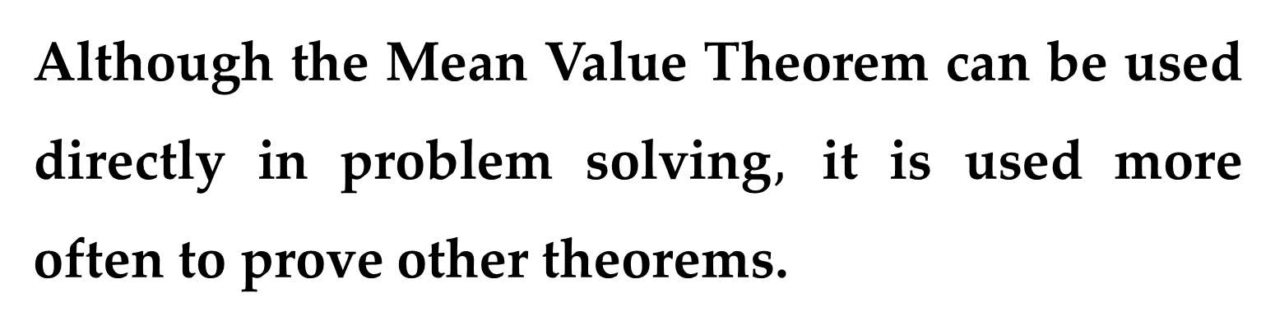
Although the Mean Value Theorem can be used directly in problem solving$,$ it is used more often to prove other theorems.
Geometrically, the theorem guarantees the existence of a tangent line that is parallel to the secant line through the points $\left(a,f\left(a\right)\right)$ and $\left(b,f\left(b\right)\right),$ as shown in $Figure 11$ (see $Example 3$).

Slide 20
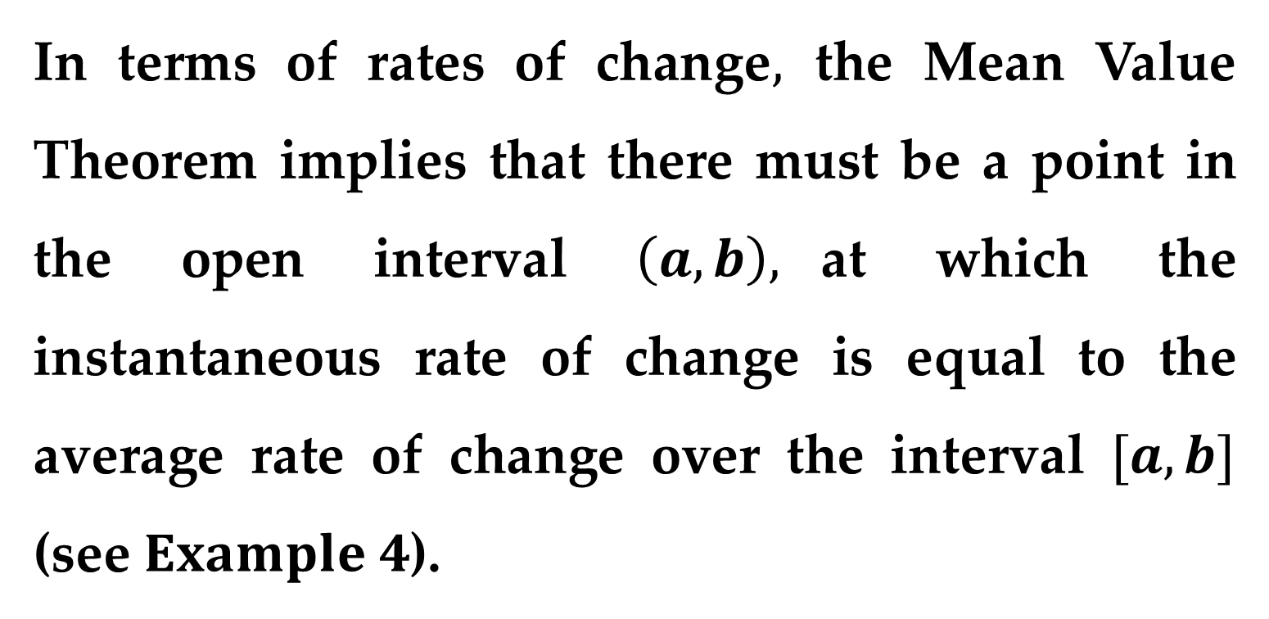
In terms of rates of change$,$ the Mean Value Theorem implies that there must be a point in the open interval $\left(a,b\right),$at which the instantaneous rate of change is equal to the average rate of change over the interval $[a,b]$ (see $Example 4$).

Slide 21
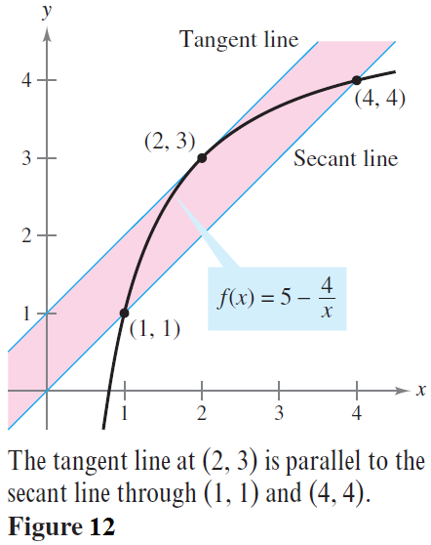
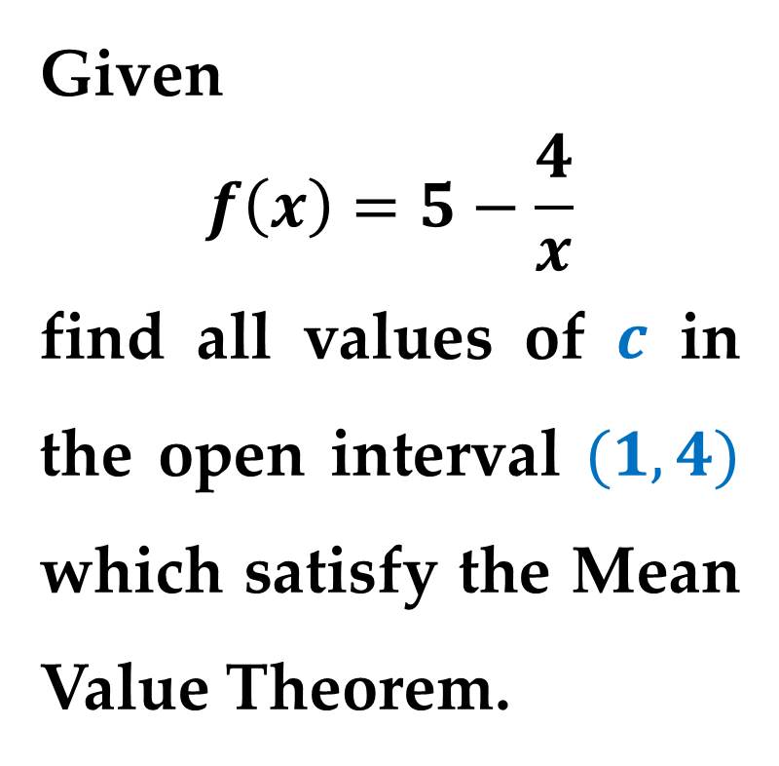
Example 3. Finding a Tangent Line
Given
$$f\left(x\right)=5−\frac{4}{x}$$
find all values of $c$ in the open interval $(1,4)$ which satisfy the Mean Value Theorem.

Slide 22
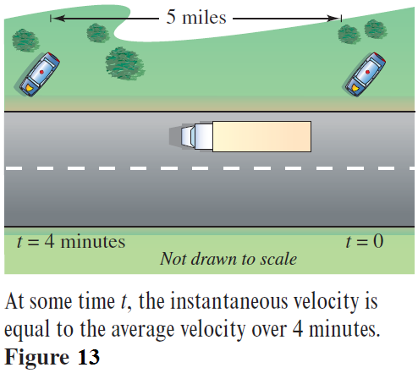
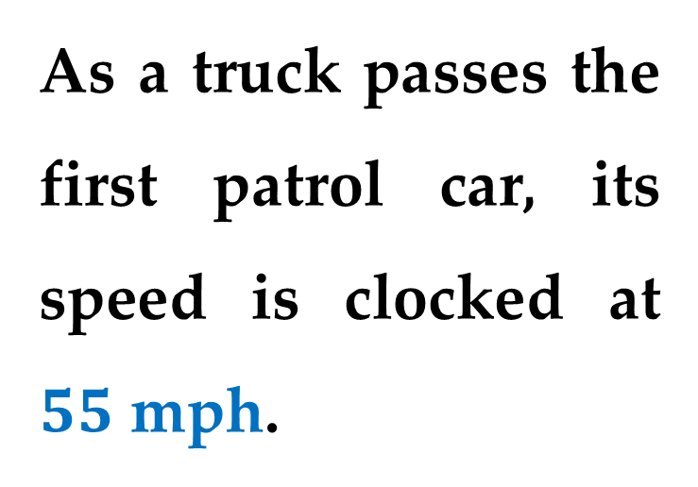
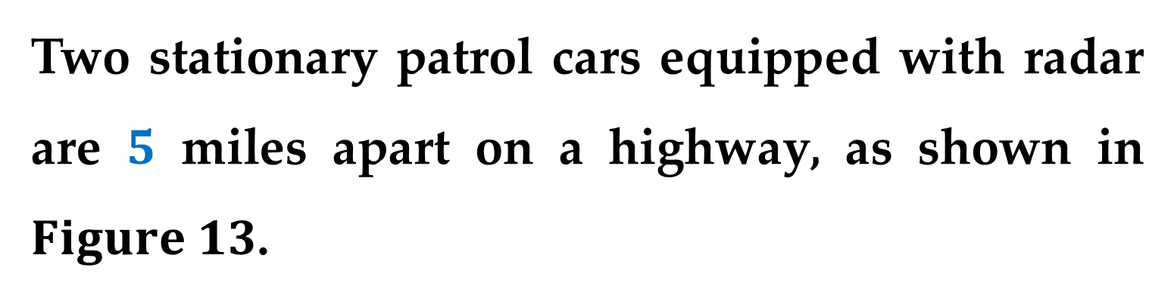
Example 4. Finding an Instantaneous Rate of Change
Two stationary patrol cars equipped with radar are $5$ miles apart on a highway, as shown in $Figure 13$.
As a truck passes the first patrol car, its speed is clocked at $55$ mph.

Slide 23
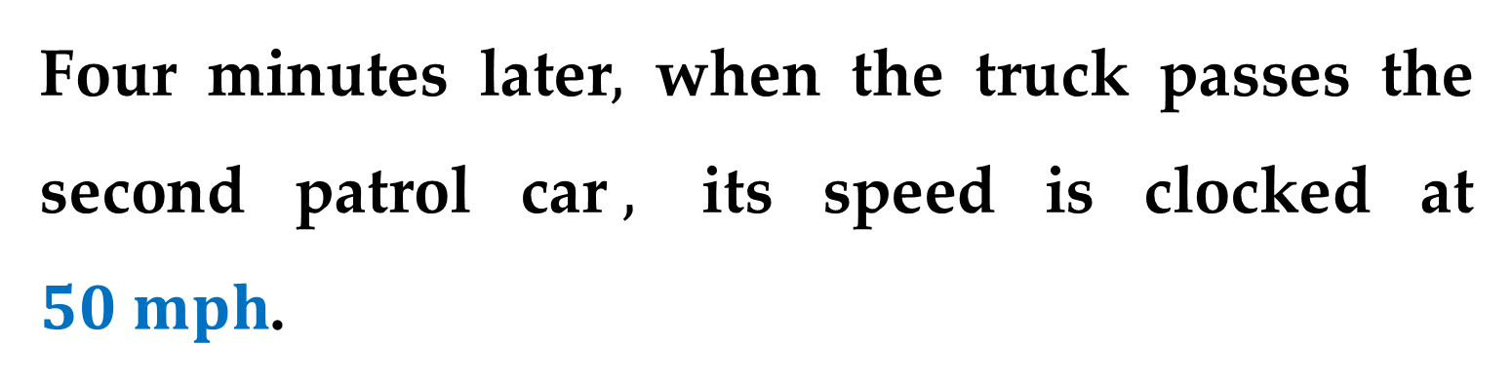
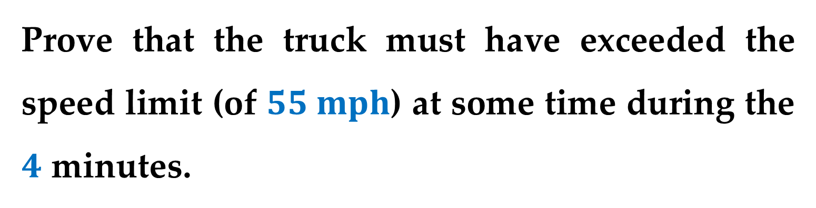
Four minutes later$,$ when the truck passes the second patrol car$,$ its speed is clocked at $50 mph$.
Prove that the truck must have exceeded the speed limit (of $55 mph$) at some time during the $4$ minutes.

Slide 24

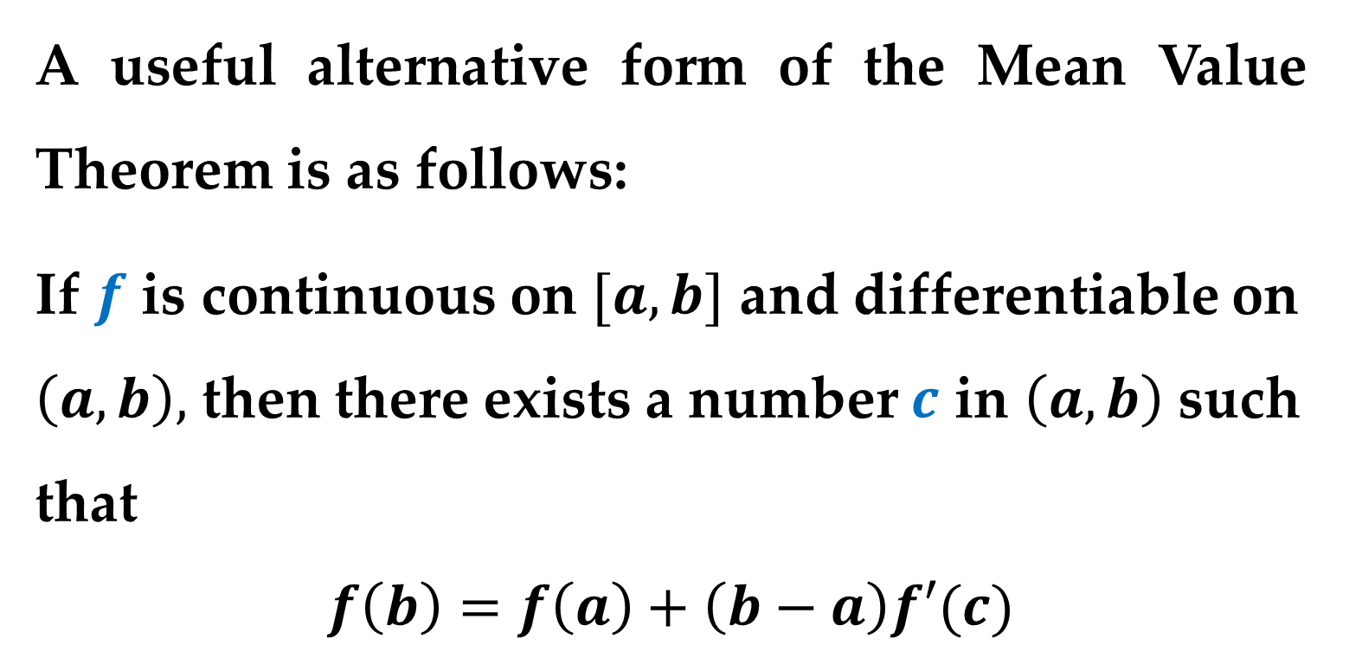
$Alternative Form of the$
$$Mean Value Theorem$$
A useful alternative form of the Mean Value Theorem is as follows:
If $f$ is continuous on $[a,b]$ and differentiable on $\left(a,b\right),$ then there exists a number $c$ in $\left(a,b\right)$ such that
$$f\left(b\right)=f\left(a\right)+\left(b−a\right)f′(c)$$

Slide 25
Note
Keep in mind that when dealing with
polynomial functions
rational functions
radical functions
trigonometric functions
they are all differentiable at all points in their domains.

Slide 26
Thank you for attention

